Slide 1


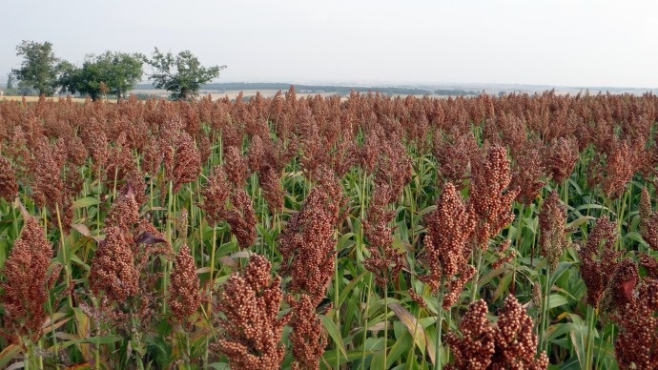
Study of the root development of sorghum
Nicolas Degives
Promoteur : Guillaume Lobet

Slide 2
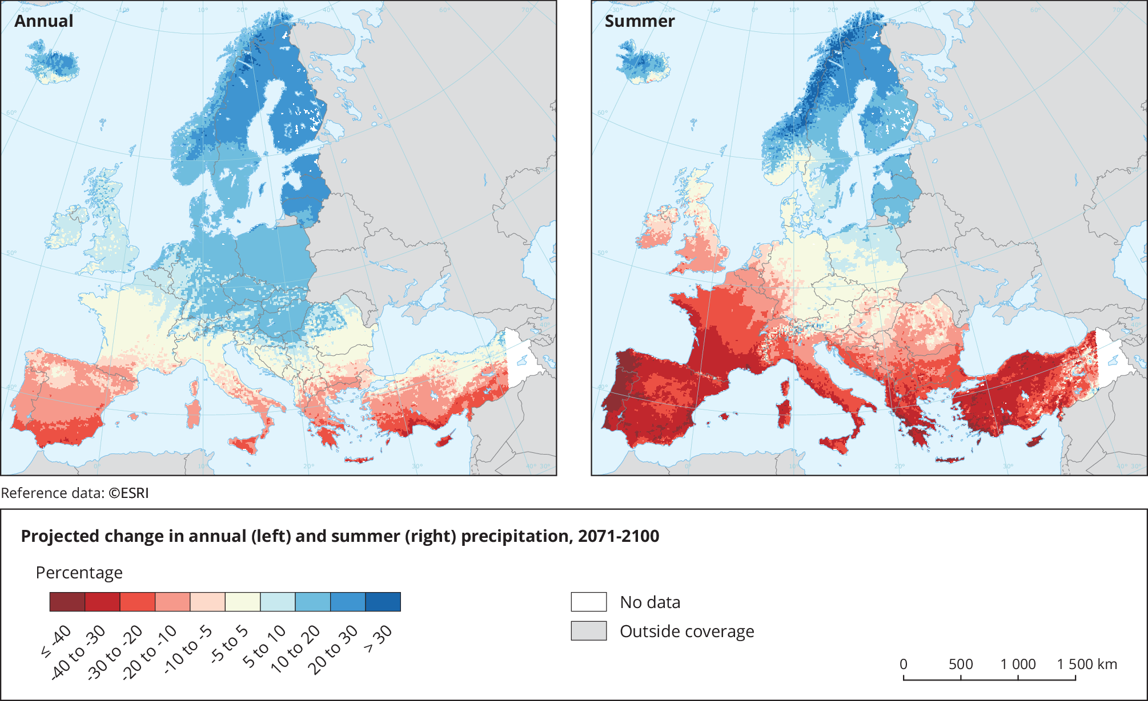
The need for resilience
Subject
Next
Completed
Context
Climate change
More summer drought due to climate change.
Need to develop crop resilience
Solution
Genetic improvement
Other crop
Projected change in annual and summer precipitation compared to 1971-2000
Source : European Environment Agency

Slide 3
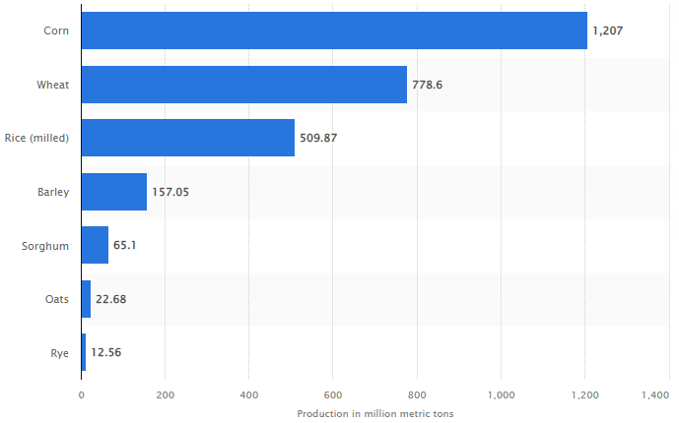
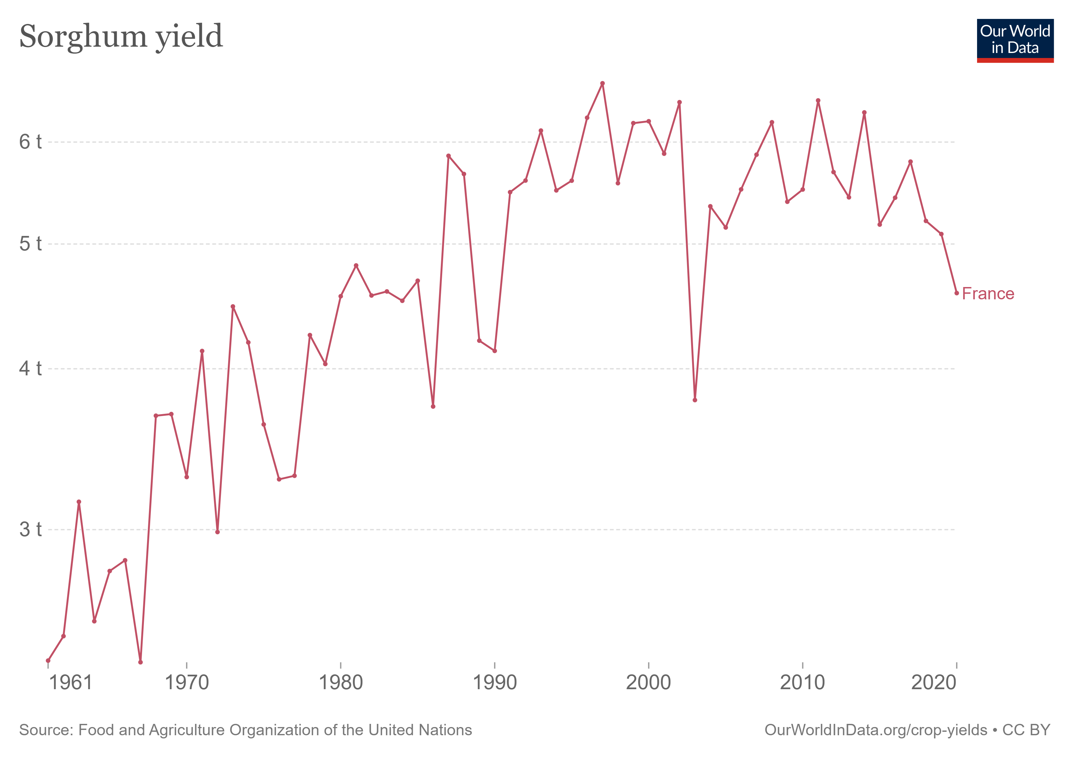
Sorghum
Subject
Next
Completed
Context
Fifth most produced cereal in the world
Multiple uses
Human food
Forage
Industry
Good properties
Water resilience
Few fertilizers
Worldwide production of grain in 2021/22
Source : https://www.statista.com/statistics/263977/world-grain-production-by-type/

Slide 4
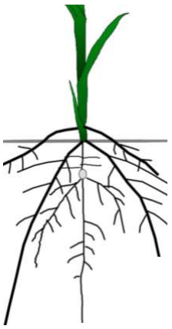
Roots
Subject
Next
Completed
Context
Many root traits influence water uptake
Root architecture
Root anatomical features
Interactions
Experimental restriction
Lack of data
Lack of knowledge
In the field Under controlled conditions
- Represent reality - Study one factor at a time
- Difficult to isolate a factor - No competition effect
- A lot of work - Affected growth by type of container and substrate
Architecture
Depth
Diameter
…
Anatomy
Xylem
Aerenchyma
…

Slide 5
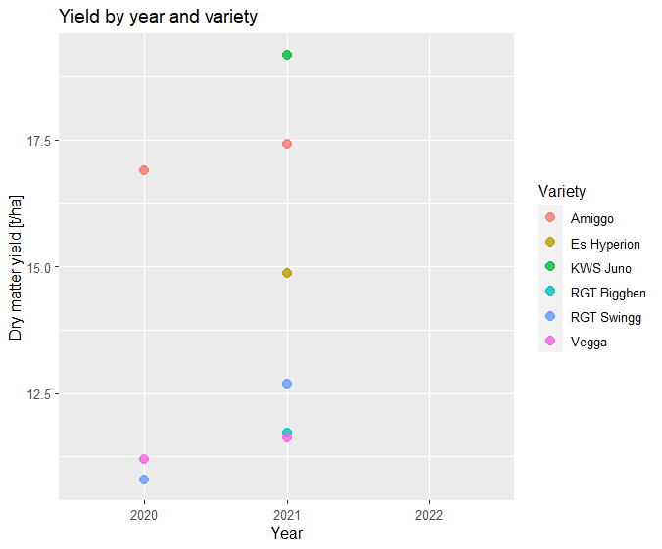
Genotype selection
Subject
Next
Completed
Context
Selection of genotypes
CIPF
Six genotypes were already tested last year
Results of the aerial parts
From 2020, 2021 and soon 2022
Differences between genotype

Slide 6
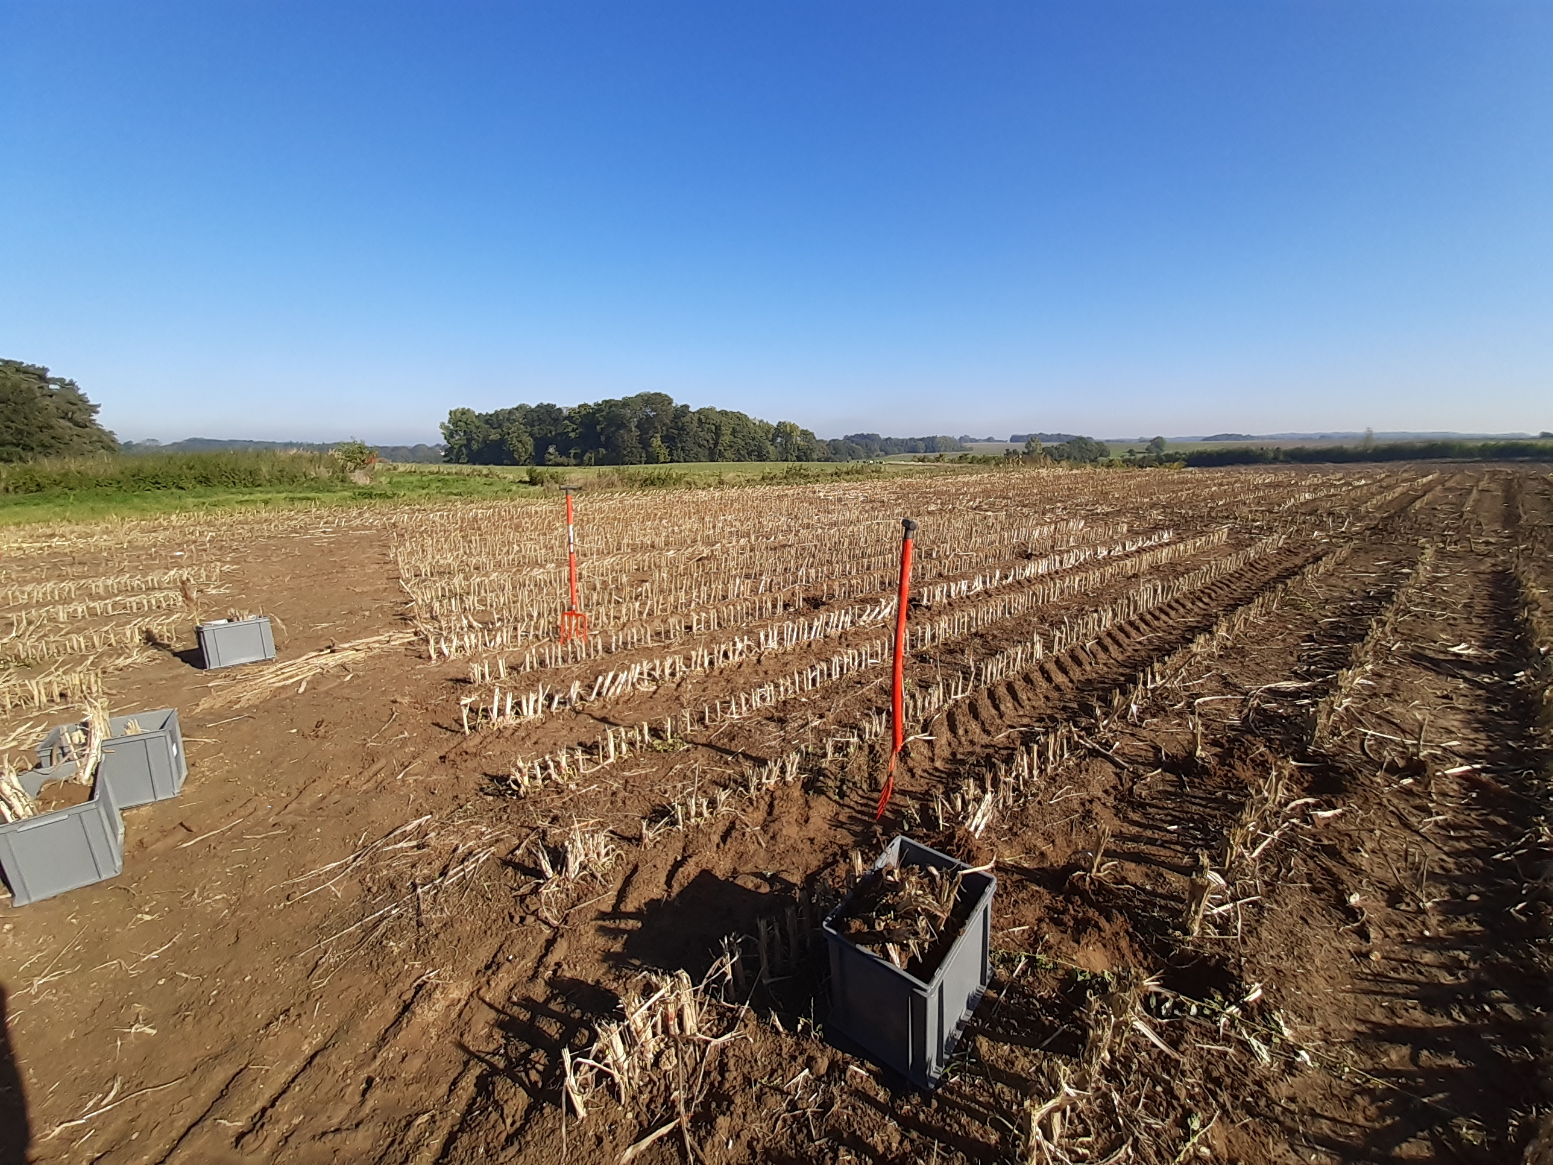
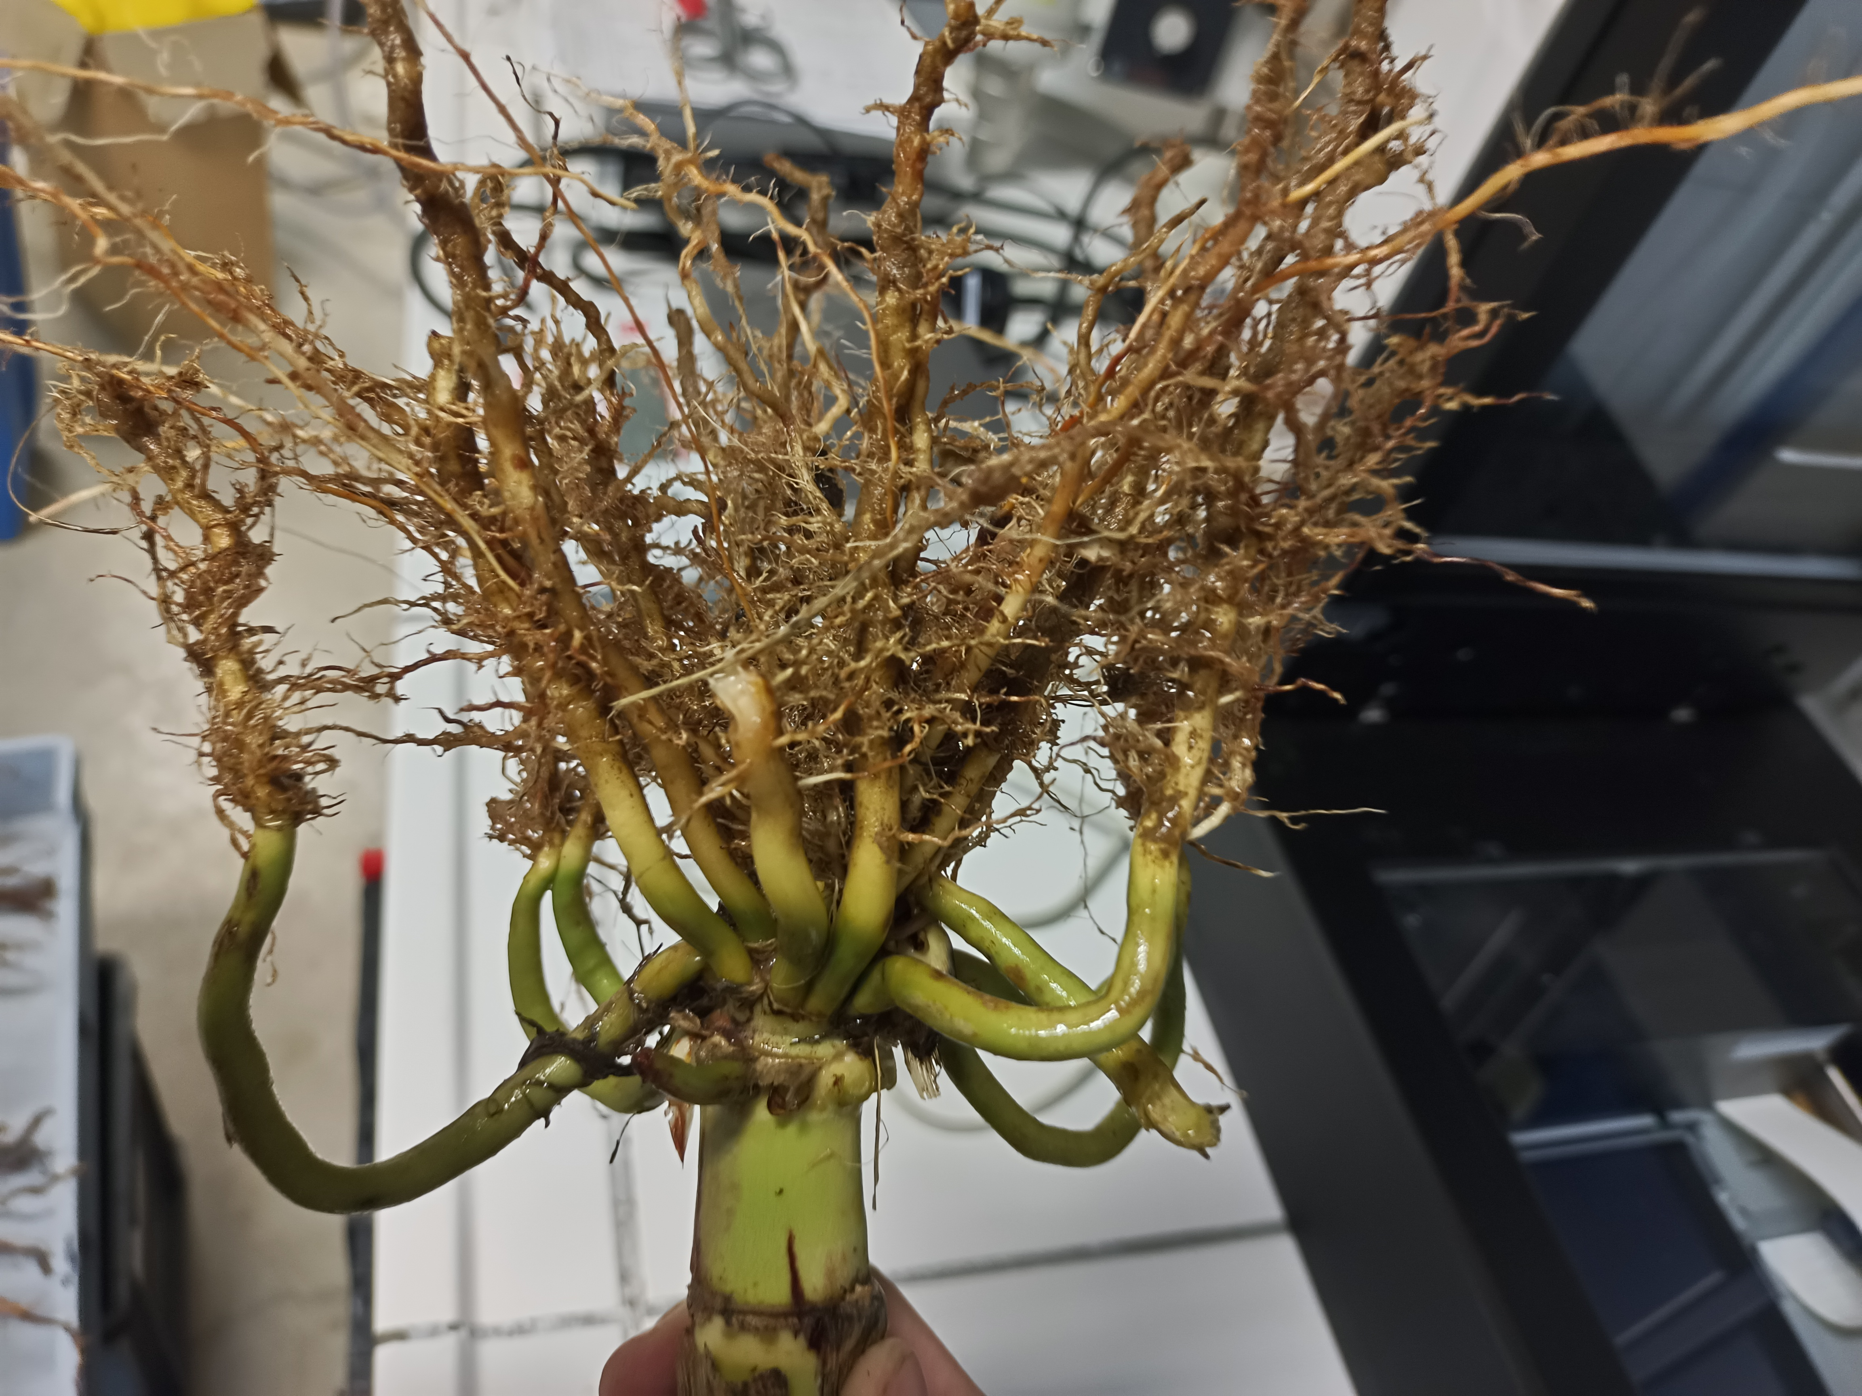
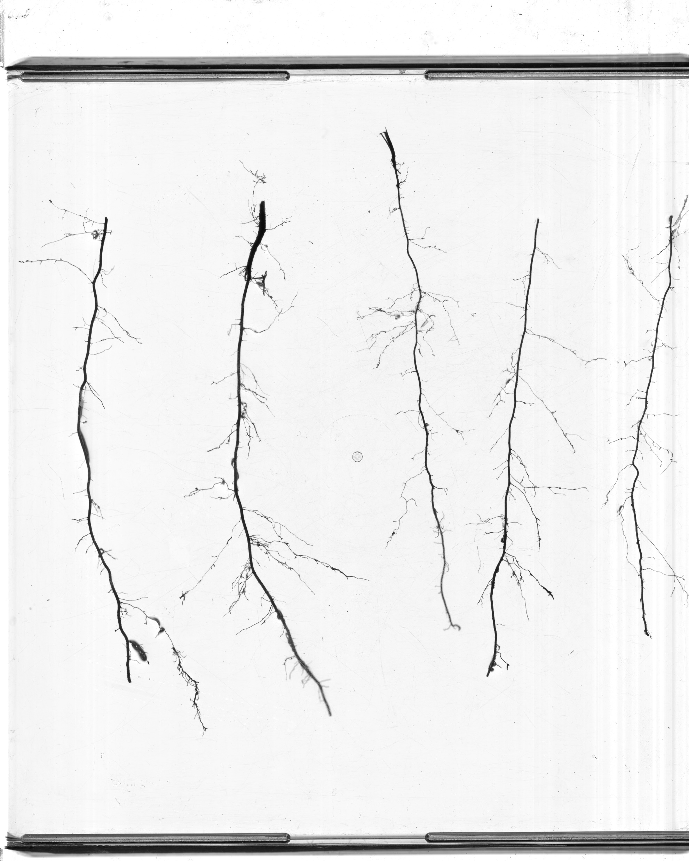
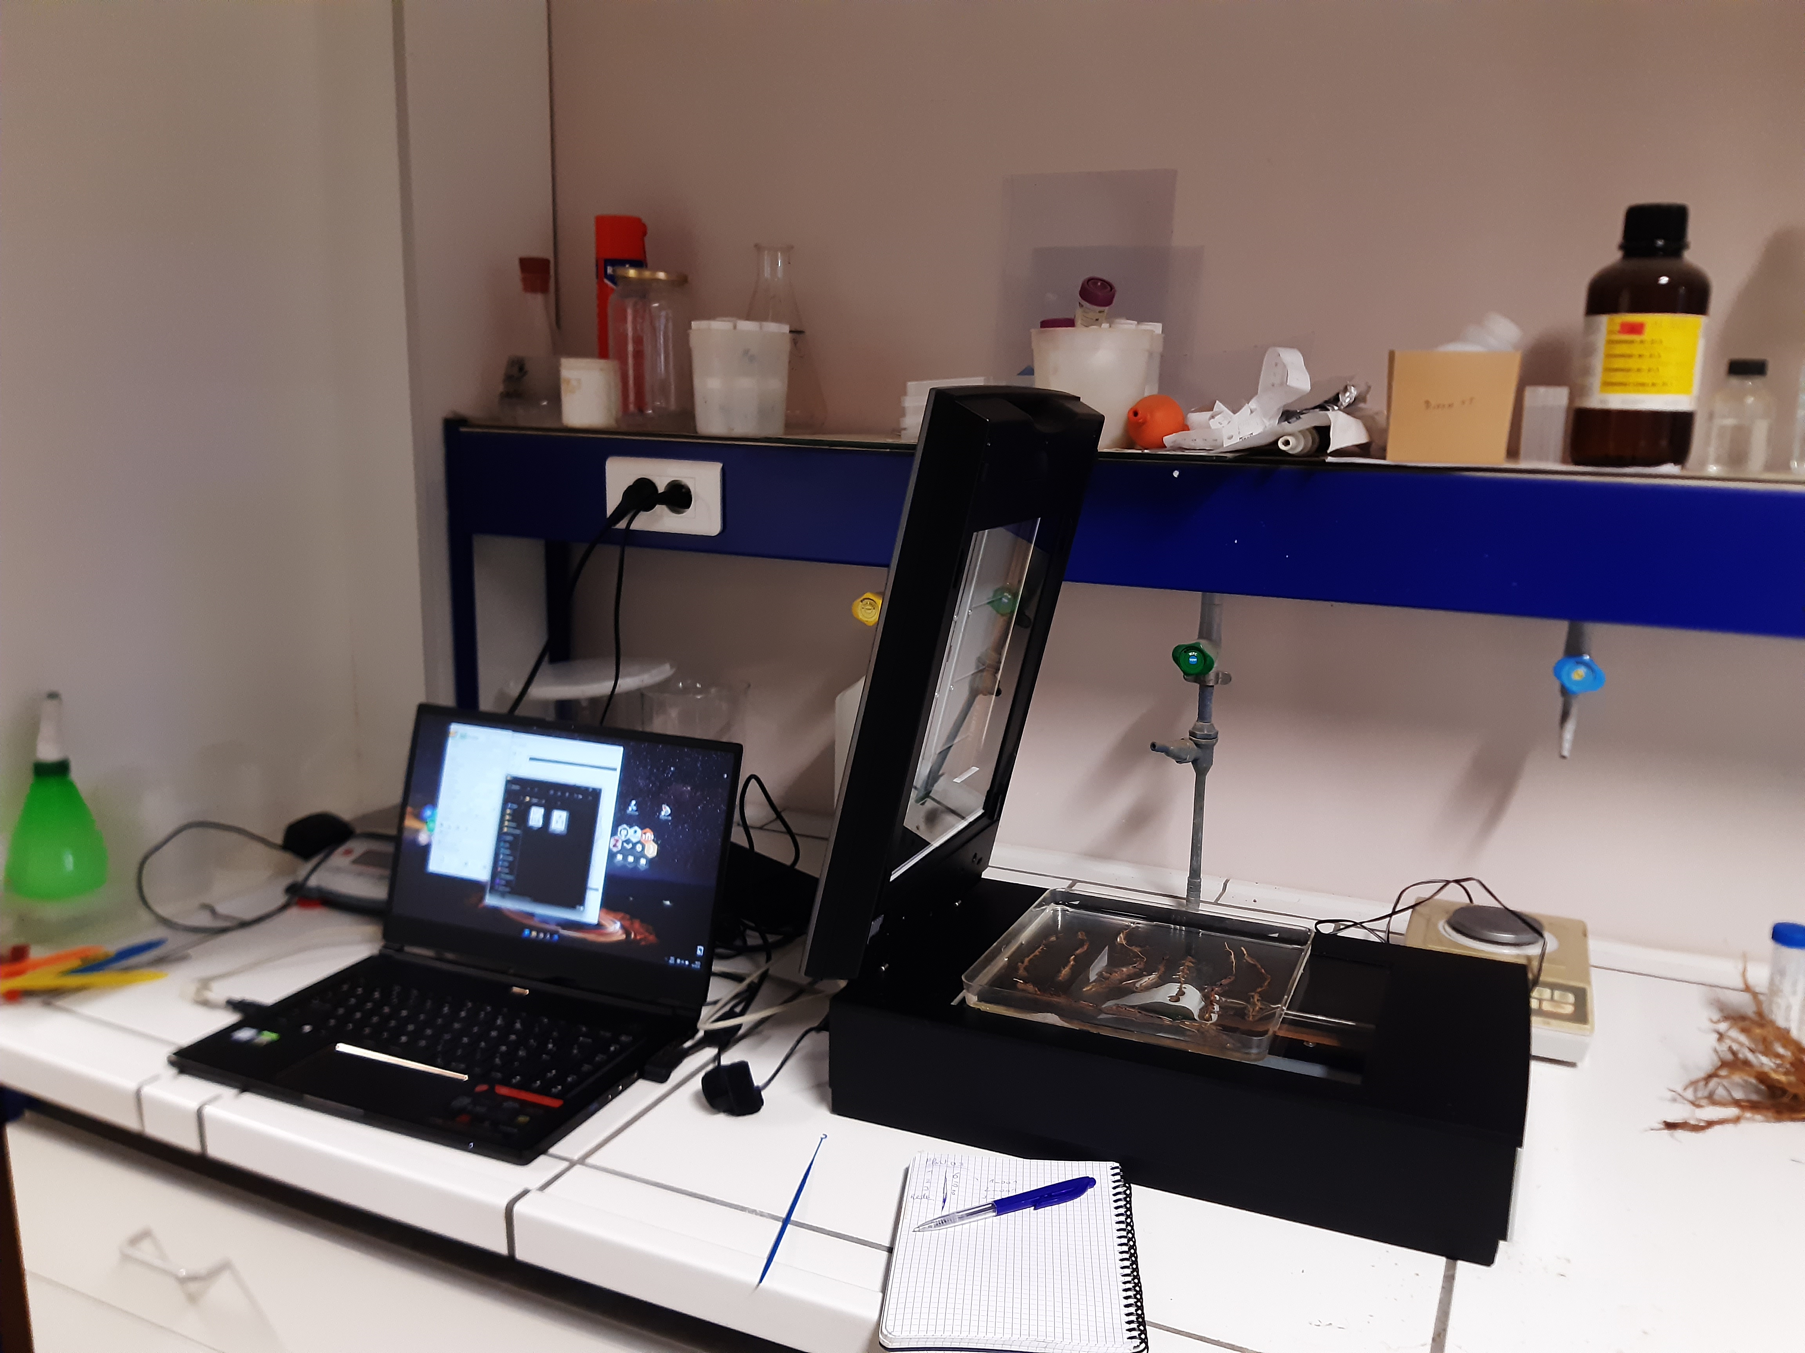
Root part
Subject
Next
Completed
Context
Root sampling of CIPF plants
Get the roots in the field
Scan them
Analyse
Data on root development later in a rhizotron

Slide 7
Coming up
Subject
Next
Completed
Context
Analysis of the roots with SmartRoot to have quantified results
Characterize the architecture
Getting started with the model(s)
More architectural (and anatomical) data later

Slide 8
Thank you

